Slide 1
2. Database System-Concepts and Architecture (3 Hrs)
Data Models, Schemas, and Instance; Three Schema Architecture and Data Independence;
Database Languages and Interfaces;
The Database System Environment; Centralized and Client/Sever Architecture for DBMSs; Classification of Database Management Systems

Slide 2
Instances and Schemas
The description of a database is called the database schema, which is specified during database design and is not expected to change frequently.
DB Schema
  captures data types, relationships, constraints on the data
  is independent of any application program
Databases change over time as data is inserted and deleted. The collection of data stored in the database at a particular moment of time is called an instance of the database. Also known as DB State.
1-<number>

Slide 3
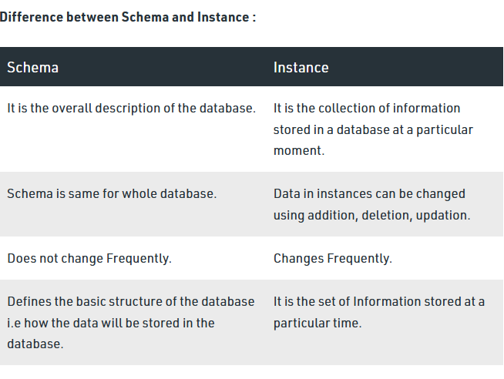

Slide 4
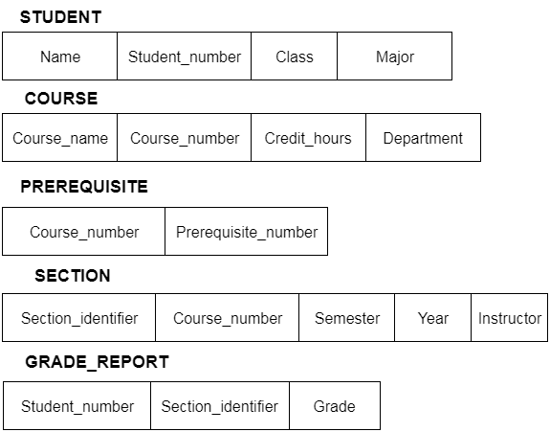
Database Schema

Slide 5
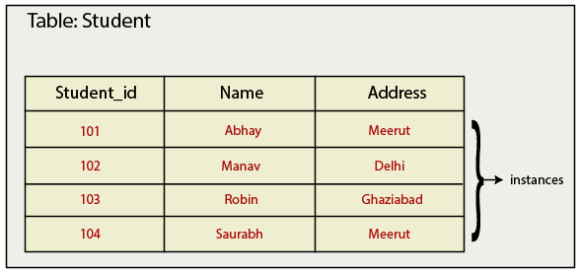
Database Instance

Slide 6
View of Data
A database system is a collection of interrelated data and a set of programs that allow users to access and modify these data.
A major purpose of a database system is to provide users with an abstract view of the data. That is, the system hides certain details of how the data are stored and maintained.

Slide 7
Data Abstraction
Data abstraction is the process providing easy interface to users by hiding all underlying complexities of data management from users.
Database System provides users with an abstract view of the data.
Data abstraction is provided in database management system by using three level schema (ANSI/SPARC)

Slide 8
DBMS Architecture
The DBMS architecture proposed by ANSI/SPARC (American National Standards Institute, Standards Planning And Requirements Committee) (ANSI/SPARC architecture) is defined at three levels. This architecture is also called three-schema architecture.
This architecture provides three levels of abstraction to simplify users’ interaction with the system.
It provides users with an abstract view of data. The system hides certain details of how data are stored and maintained.
The goal of this architecture is to separate the user applications from physical database.
It divides the system into three levels of abstraction: the internal or physical level, the logical or conceptual level, and the external or view level.

Slide 9
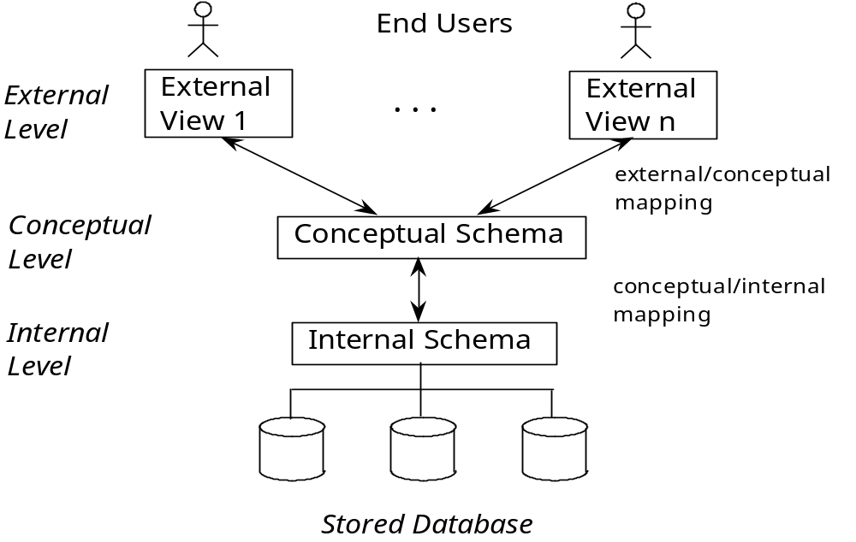
DBMS Architecture
1-<number>

Slide 10
DBMS Architecture
Physical Level or Internal Level:
  It is the lowest level of abstraction and describes how the data in the database are actually stored.
  This level describes complex low-level data structures in detail and is concerned with the way the data is physically stored.
  Data only exists at physical level.
Logical Level or Conceptual Level:
  This is the next higher level of abstraction and describes what data are stored in the database, and what relationships exist among those data.
  It describes the structure of whole database and hides details of physical storage structure.
  It concentrates on describing entities, data types, relationships, attributes and constraints.
  All of the views must be derivable from this conceptual schema.

Slide 11
DBMS Architecture
View Level or External Level:
  It is the highest level of abstraction and is concerned with the way the data is seen by individual users.
  This level simplifies the users’ interaction with the system.
  It includes a number of user views and hence is guided by the end user requirement.
  It describes only those part of the database in which the users are interested and hides rest of all from those users. Each user group refers to its own external schema.
The DBMS must transform a request specified on an external schema into a request against the conceptual schema, and then into a request on the internal schema for processing over the database. The process of transforming requests and results between levels is called mapping.

Slide 12
Data Independence
The three schema architecture can be used to explain the concept of data independence , which can be defined as the capacity to change the schema at one level of a database system without having to change the schema at the next higher level. We can define two type of data independence:
  Logical Data Independence
  Physical Data Independence

Slide 13
Logical Data Independence
Logical data independence is the capacity to change the conceptual schema without having to change external schemas or application programs. We may change the conceptual schema to expand the database or to reduce the database. In the latter case, external schemas that refer only to the remaining data should not be affected.
Only the view definition and the mappings need be changed in a DBMS that supports logical data independence. Application programs that reference the external schema constructs must work as before, after the conceptual schema undergoes a logical reorganization. Changes to constraints can be applied also to the conceptual schema without affecting the external schemas or application programs

Slide 14
Physical Data Independence
Physical data independence is the capacity to change the internal schema without having to change the conceptual (or external) schemas. Changes to the internal schema may be needed the conceptual (or external) schemas.
Changes to the internal schema may be needed because some physical files had to be reorganized- for example, by creating additional access structure- to improve the performance or retrieval or update.
If the same data as before remain in the database, we should not have to change the conceptual schema.

Slide 15
Data Independence
When a schema at a lower level is changed, only the mappings between this schema and higher-level schemas need to be changed in a DBMS that fully supports data independence.
The higher-level schemas themselves are unchanged.
Hence, the application programs need not be changed since they refer to the external schemas.

Slide 16
Data Models
Data models describe how a database’s logical structure is represented. In a database management system, data models are essential for introducing abstraction.
Data models specify how data is linked one another, as well as how it is handled and stored within the system.
Data model provides the conceptual tools for describing the design of a database at each level data abstraction.
Data model defines the data elements and the relationships between the data elements.
Data model gives an ides that how final system will look like.

Slide 17
Data Models
The basic structure or design of the database is the data model. A data model is a collection of conceptual tools for describing data, data relationships, data semantics, and consistency constraints. Some data models are given below:
Entity-Relationship Model:
  Entity-relationship (E-R) model is a high level data model based on a perception of a real world that consists of collection of basic objects, called entities, and of relationships among these entities.
  An entity is a thing or object in the real world that is distinguishable from other objects.
  Entities are described in a database by a set of attributes.
  A relationship is an association among several entities.
  The set of all entities of the same type is called an entity set and the set of all relationships of the same type is called a relationship set.
1-<number>

Slide 18

Data Models
  Overall logical structure of a database can be expressed graphically by E-R diagram. The basic components of this diagram are:
    Rectangles (represent entity sets)
    Ellipses (represent attributes)
    Diamonds (represent relationship sets among entity sets)
    Lines (link attributes to entity sets and entity sets to relationship sets)
  The figure below shows an example of E-R diagram.

Slide 19
Data Models
Relational Model:
  It is the current favorite model. The relational model is a lower level model that uses a collection of tables to represent both data and relationships among those data. Each table has multiple columns, and each column has a unique name. Each table corresponds to an entity set or relationship set, and each row represents an instance of that entity set or relationship set.
  Relationships link rows from two tables by embedding row identifiers (keys) from one table as attribute values in the other table.
  Structured query language (SQL) is used to manipulate data stored in tables.

Slide 20

  Fig: A sample relational database

Slide 21
Data Models
  The relational data model is the most widely used data model, and a vast majority of current database systems are based on the relational model.
  The relational model is at a lower level of abstraction than the E-R model.
  Database designs are often carried out in the E-R model, and then translated to the relational model.

Slide 22
Data Models
Hierarchical Model:
  This model assumes that a tree structure is the most frequently occurring relationship.
  It hierarchical data model is the oldest type of data model. It is the record based representation data model.
  In this model, different records are interrelated through hierarchical structure.
  The root may have any number of dependents, each of these dependents may have any number of lower level dependents.

Slide 23
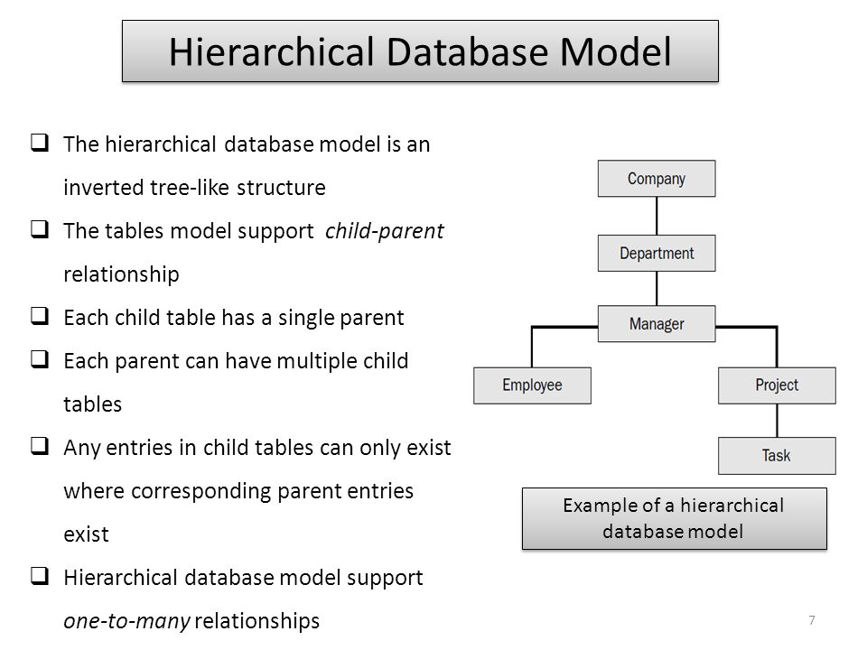

Slide 24
Data Models
Network Model:
  A network model is an extension of the hierarchical database structure. It is more flexible than hierarchical data model
  The network model replaces the hierarchical tree with a graph thus allowing more general connections among the nodes.
  This model was evolved to specially handle non-hierarchical relationships.

Slide 25
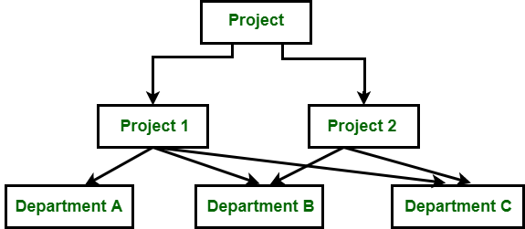
Data Models
Figure: Network Model

Slide 26
Data Models
Object-oriented Data Model:
  This model represents an entity set as a class. A class represents both object attributes as well as the behavior of the entity.
  Instances of class are objects. Within an object, the class attributes take specific values. However the behavior patterns of the class is shared by all the objects belonging to the class.
  Attribute values can be primitive data types usually associated with databases and programming languages or other objects. The object-oriented model maintains relationships through ‘logical-containment’.

Slide 27
Data Models
Object Oriented Data Model: The object oriented data model is based on object oriented programming paradigm.
A core object oriented data model consists of the following basic object oriented concepts:
Object: Any real world entity is uniformly modeled as an object
Attributes and method: Every object has a state (set of values for the attributes of the object) and a behavior (the set of methods-program code-which operate on the state of the object). The state and behavior encapsulated in single place using class.

Slide 28
Data Models
Class: a means of grouping all the objects which share the same set of attributes and methods. An object must belong to only one class. A class is similar is an abstract data type

Slide 29
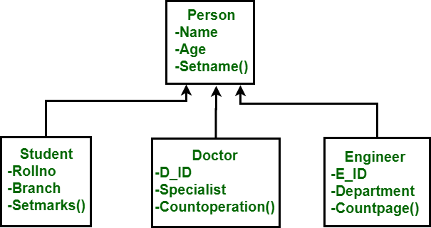
Data Models
Figure: Object Oriented Data Model

Slide 30
Database Languages
Languages that are used to interact with database management systems are called database languages.
DBMS provides two languages: Data- Definition Language (DDL) and Data Manipulation Language(DML).
In current DBMSs, the preceding types of languages are usually not considered distinct languages(SQL); rather, a comprehensive integrated language is used that includes constructs for conceptual schema definition, view definition, and data manipulation.

Slide 31
Database Languages
Data Definition Language: Database language is used to create, delete or modify database schema is called data definition language.
DDL statements are converted into equivalent low level statements by DDL interpreter. DDL is used by DBA. SQL supports following DDL statements:

Slide 32
Database Languages
Create Statement
Drop Statement
Alter Statement

Slide 33
Create Statement
CREATE TABLE account
(
account_number CHAR(10),
balance INTEGER,
branch CHAR(10)
)

Slide 34
DROP STATEMENT
DROP TABLE Table_name
DROP TABLE account

Slide 35
ALTER TABLE
Allows us to modify a given table
Removing a existing column:
ALTER TABLE Table_name
DROP (column_name)
Adding new Column
ALTER TABLE Table_name
ADD (column name datatype)

Slide 36
Data Manipulation Language
Data Language that enables insert, delete, update and retrieve data from database is called data manipulation language (DML). Query language is only a part of data manipulation language.
DML statements are converted into equivalent low level statements by DML compiler.
SQL supports following DML statements
Insert Statement
Delete Statement
Update Statement
Select Statement

Slide 37
Data Manipulation Language
Insert Statement: The insert statement is used to insert a record into a table.
insert into table_name values (value1, value2,….)

Slide 38
Data Manipulation Language
Delete Statement: It is used to delete rows from table.
DELETE FROM table_name
WHERE (condition)

Slide 39
The SQL SELECT Statement
The SELECT statement is used to select data from a database.
The data returned is stored in a result table, called the result-set.
SELECT Syntax
SELECT column1, column2, ...
FROM table_name;

Slide 40
The SQL SELECT Statement…
Here, column1, column2, ... are the field names of the table you want to select data from.
If you want to select all the fields available in the table, use the following syntax:
SELECT * FROM table_name;

Slide 41
The SQL SELECT Statement
The SELECT statement is used to select data from a database.
The data returned is stored in a result table, called the result-set.
SELECT Syntax
SELECT column1, column2, ...
FROM table_name;

Slide 42
The SQL SELECT Statement…
Here, column1, column2, ... are the field names of the table you want to select data from.
If you want to select all the fields available in the table, use the following syntax:
SELECT * FROM table_name;

Slide 43
SQL UPDATE Statement
SQL UPDATE: SQL UPDATE is used to change the data of the records held by tables. Which rows to be updated, it is decided by a condition. To specify condition, we use WHERE clause.
UPDATE table_name [set column_name1=value1,….]
WHERE <condition>

Slide 44
Database Applications Architectures
DBMS application architecture describes the structure and how the users are connected to a specific database system.
It also affects the performance of the database as it helps to design, develop, implement and maintain the database management system.
There are two types of DBMS architecture in use.
Centralized Database Architecture.
Client Server Database System Architecture.

Slide 45
Database Applications Architectures
Centralized Database Architecture: In centralized database systems, the database system, application programs and user interface all are executed on a single system and dummy terminals are connected to it.
The processing power of single system is utilized and dummy terminals are used only to display the information. As the personal computers became faster, more powerful, and cheaper, the database system started to exploit the available processing power of the system at the user’s side, which led to the development of client/server architecture

Slide 46
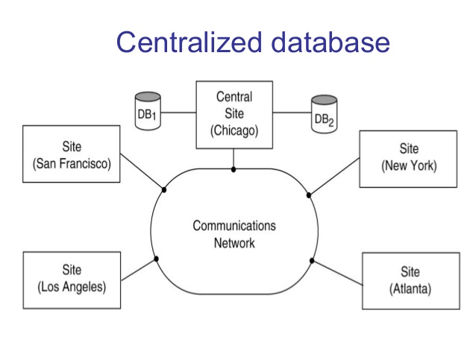
Database Applications Architectures

Slide 47
Database Applications Architectures
Client –Server Database Systems : In client/server architecture, the processing power of the computer at the user’s end is utilized by processing the user-interface on that system.
A client is a computer system that sends requests to the server connected to the network and a sever is a computer system that receives the request, processes it and returns the requested information back to the client.
Client and server are usually present at different sites. The end users work on the client computer system and database system runs on the server.

Slide 48
Database Applications Architectures
There are two approaches to implement client/server architecture: two-trier architecture and three-tier architecture.
In two tier architecture, the user interface and application programs are placed on the client side and the database systems on the server side.
In the second approach, that is, three tier architecture is primarily used for web based applications. It add intermediate layer known as application server( web server) between the client and database server.

Slide 49
Database Applications Architectures
The client communicates with the application server which in turn communicates with the database server.
The application server stores the business rules used for accessing data from database server.
It checks the clients credentials before forwarding a request to database server. Hence, it improves database server.
When a client requests for information, the application server accepts the request, processes it, and sends corresponding database commands to database server.

Slide 50
Database Applications Architectures
The database server sends the result back to application server which is converted into GUI format and presented to the client.
The business layer is typically developed using Java, Python etc.

Slide 51
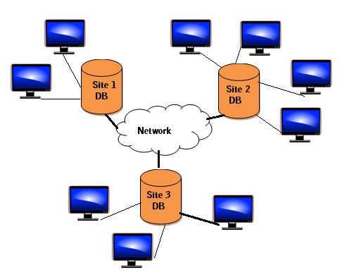
Database Applications Architectures

Slide 52
Classification of DBMs
The DBMS can be classified into different categories on the basis of several criteria such as the data model they are using, number of users they support and purpose they serve
Based on Data Models
Based on Number of Users
Based on Number of Sites
Based on Purpose

Slide 53
Based on Data Models
Depending on the data model they use, the DBMs can be classified as hierarchical, network, relational, object oriented and object oriented relational etc.
Among these, the hierarchical and network data models are legacy data models. Some of the old applications still run on the database systems based on these models.
Most of the popular and current commercial DBMSs are based on relational data model.
The object oriented based models have been implemented in some DBMSs; however, have not become popular yet.

Slide 54
Based on Data Models
Due to popularity of relational database, the object oriented concepts have been introduced in these databases that led to the development of a new class of DBMSs called object relational DBMSs.

Slide 55
Based on Number of Users
Depending on the number of users the DBMS supports, it is divided into two categories, namely, single user system and multi-user system.
In single user system, the database resides on one computer and is only accessed by one user at a time.
In most of the enterprises, the large amount of data is to be managed and accessed by multiple users and thus, requires multi-user systems.
In multi-user system, multiple users can access the database simultaneously.

Slide 56
Based on Number of Sites
Depending on the number of sites over which the database is distributed, it is divided into two types: centralized and distributed database systems.
Centralized database systems run on a single computer system. Both the database and DBMSs software reside at a single computer site. The user interacts with the centralized system through a dummy terminal connected to it for information retrieval.
In distributed database systems, the database and DBMS are distributed over several computers located at different sites

Slide 57
Based on Number of Sites
The computer communicates with each other through various communication media.
Distributed databases are of two types:
Homogeneous distributed database : In homogeneous distributed database systems, all sites have identical database management system software.
Heterogeneous distributed database : In heterogeneous distributed database system, different sites use different database management system software,

Slide 58
Based On the Purpose
Depending on the purpose of DBMS server, it can be classified as general purpose or specific purpose.
Most of the DBMS is a general purpose software system.
It can also be designed for specific purposes such as airline or railways reservation.
Such applications can not used for other applications without doing some major changes.

Slide 59
TU Old Questions
What is difference between logical data independence and physical data independence. [5] 078
What is data abstraction? What are three levels of data abstraction? Explain. [2+3] [077]
What is data definition language? How is it different from data manipulation language [2+3]-076
What is database system architecture? Describe three levels and benefits of this architecture [ 1+4] [2074]

